Slide 1
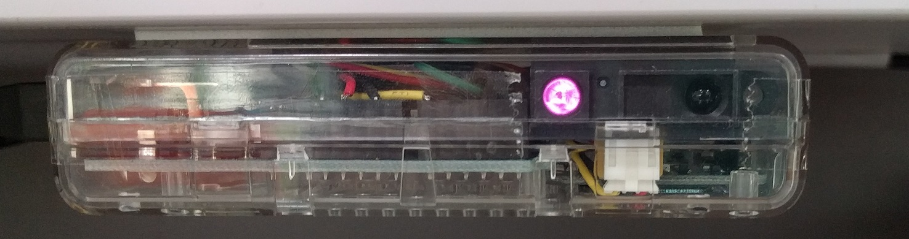
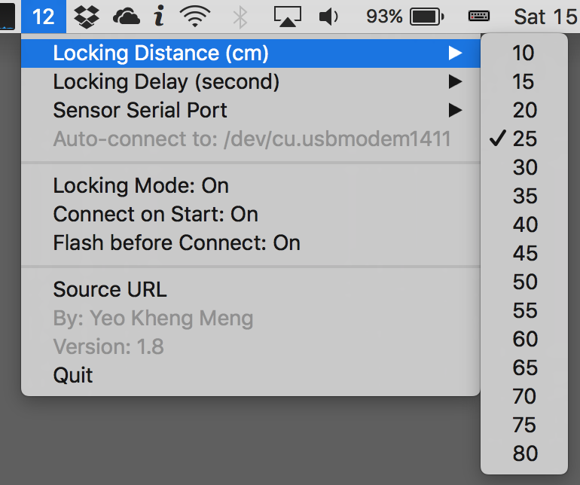
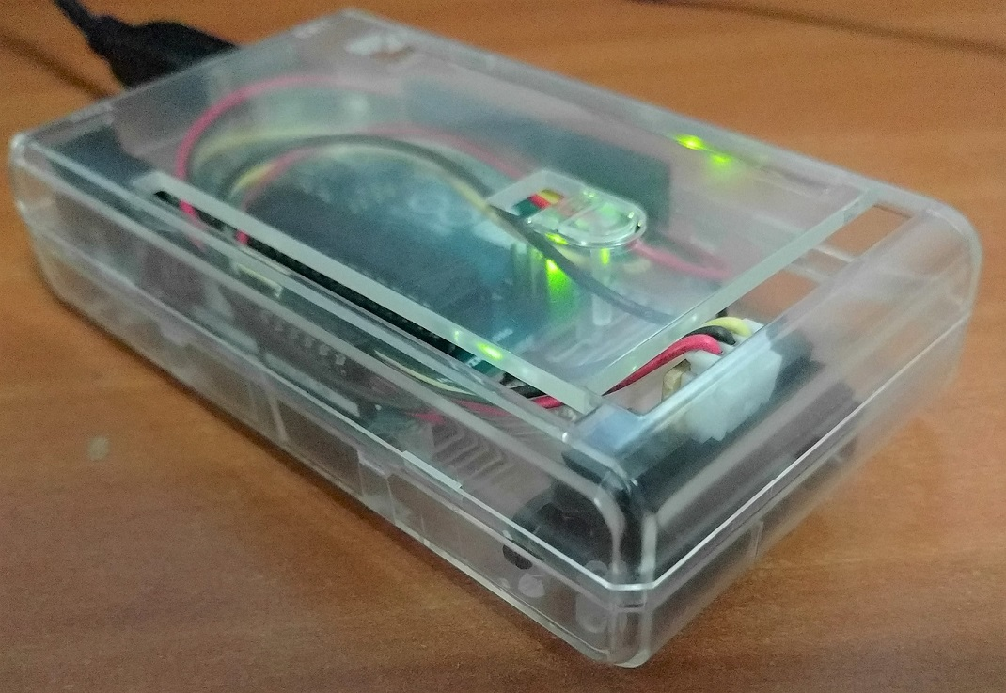
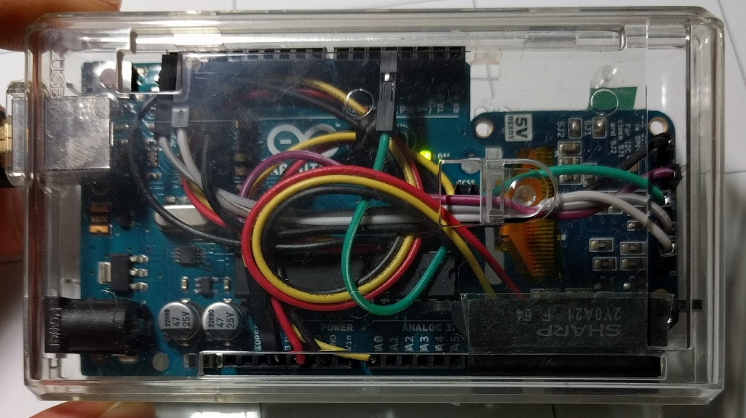
Distance Machine Locker
iOS Dev Scout (25 Apr 2017)
SP Digital Tech Talk (12 Jan 2017)
By: Yeo Kheng Meng (yeokm1@gmail.com)
and Vina Rianti (https://github.com/vinamelody)
https://github.com/yeokm1/distance-machine-locker

Slide 2
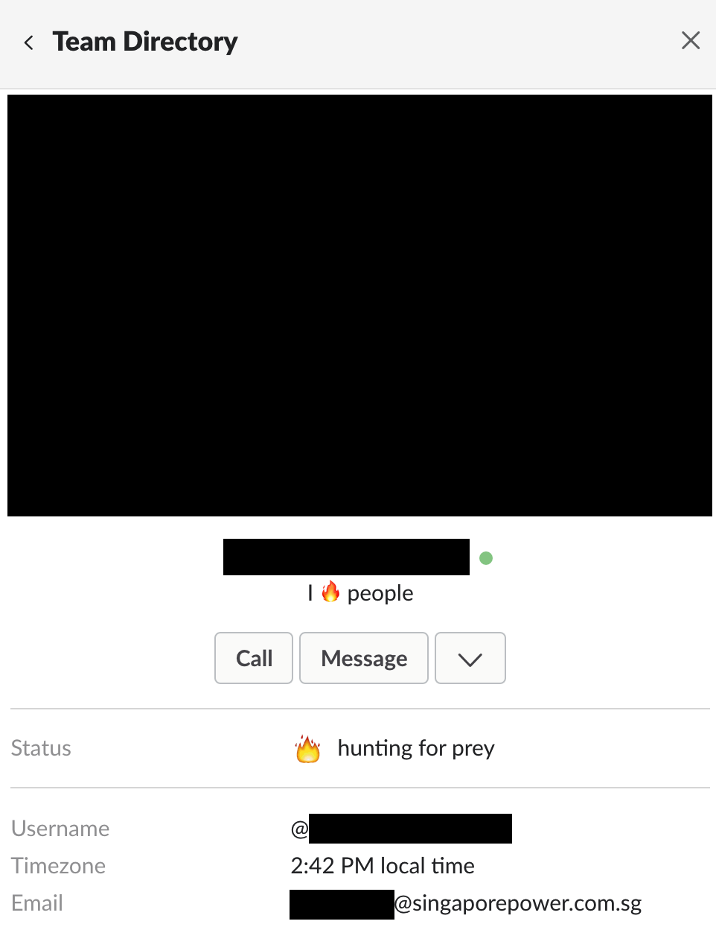



Problem?
Red Team
+ unlocked machines

Slide 3

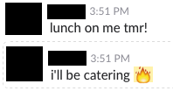
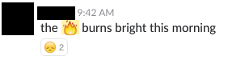
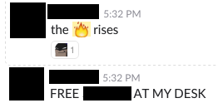

Trail of destruction

Slide 4
Solution?
Distance-measuring system
Locks machine when I leave

Slide 5
Demo

Slide 6
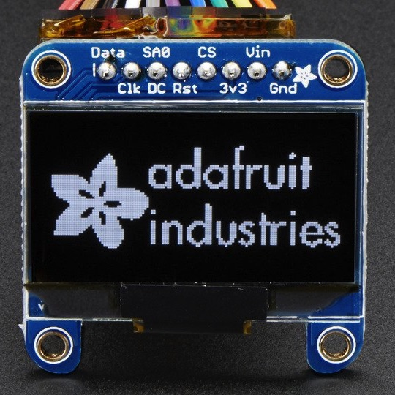
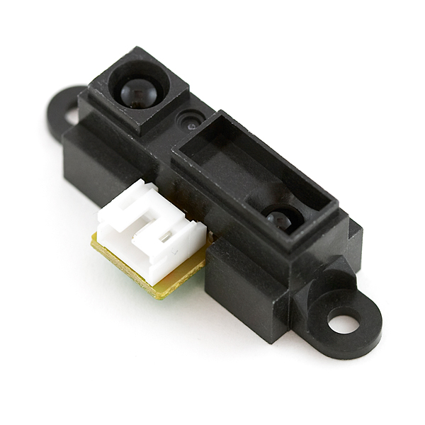
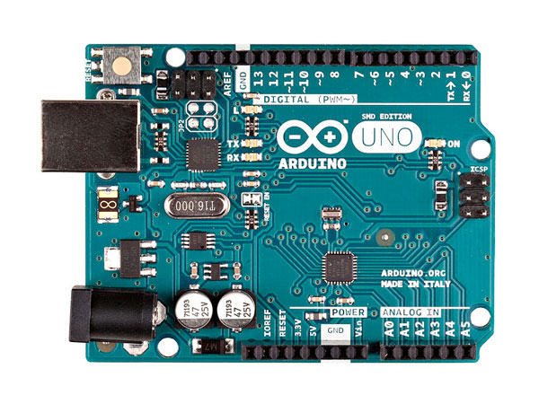
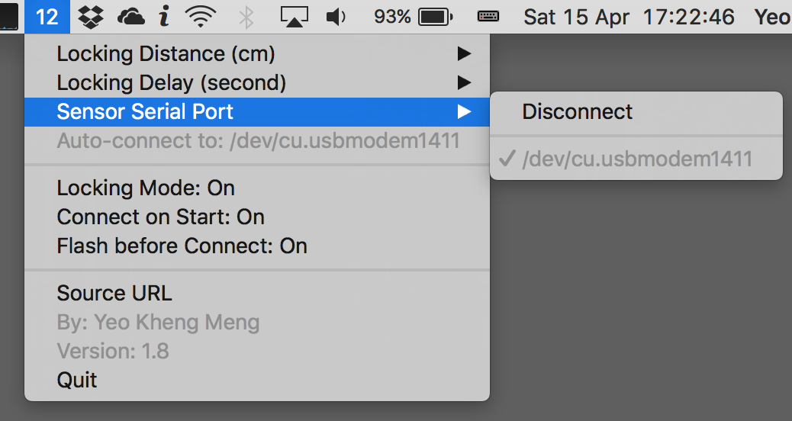
System setup overview
OLED screen
(Debugging)
Distance Sensor
Arduino Uno
Mac Menubar app

Slide 7
Agenda
Hardware Device
Swift App
Defensive strategies
Vina’s contribution

Slide 8
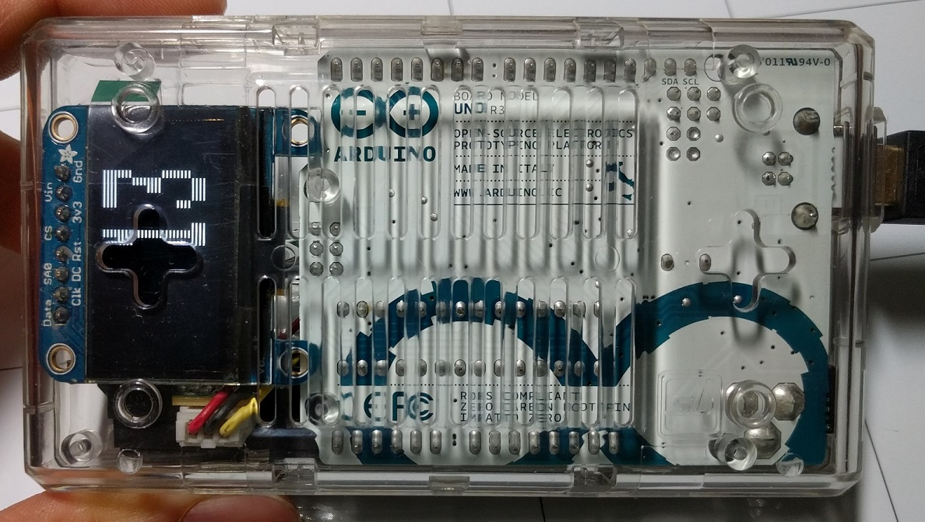
Hardware

Slide 9
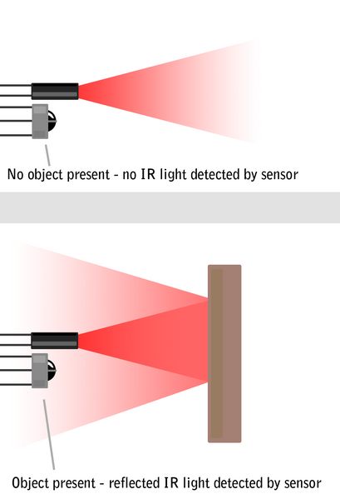

Active IR distance sensor
Infrared (IR) Distance Sensor GP2Y0A21YKR
Effective range: 10 to 80cm
Active IR
Source: http://education.rec.ri.cmu.edu/content/electronics/boe/ir_sensor/1.html

Slide 10
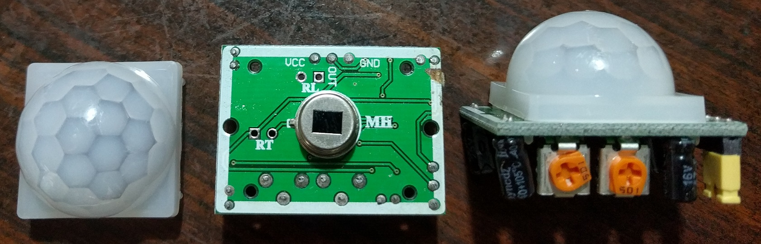
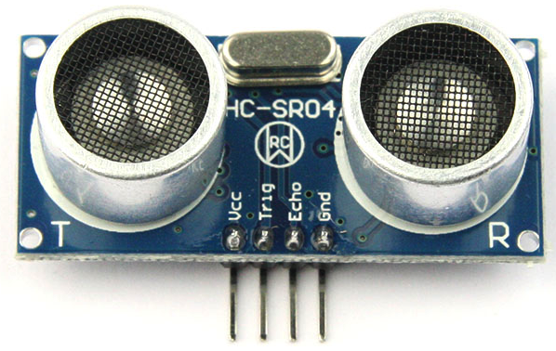
Alternative sensors?
Passive IR
7m
120° cone
High false positives
Ultrasonic
2cm to 4m
Lack precision
Noisy

Slide 11
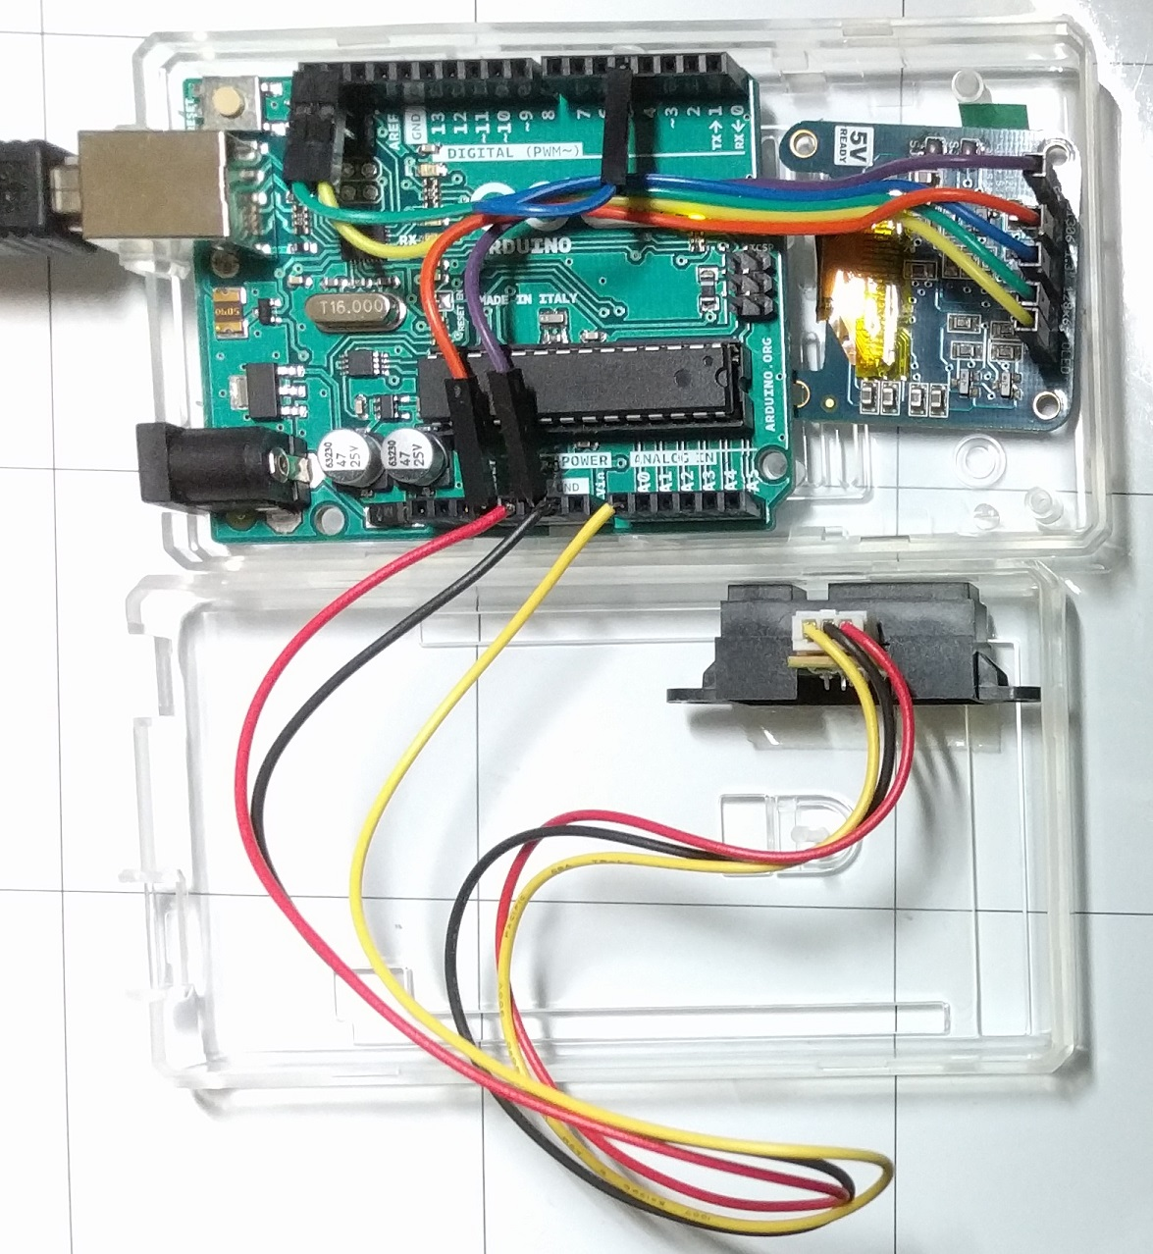
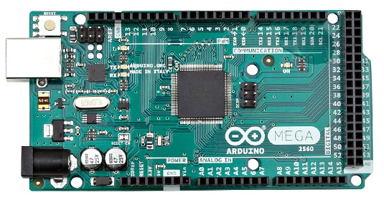
Putting them all together
Arduino Uno in case meant for Mega 2560
Arduino Uno
Arduino Mega 2560

Slide 12
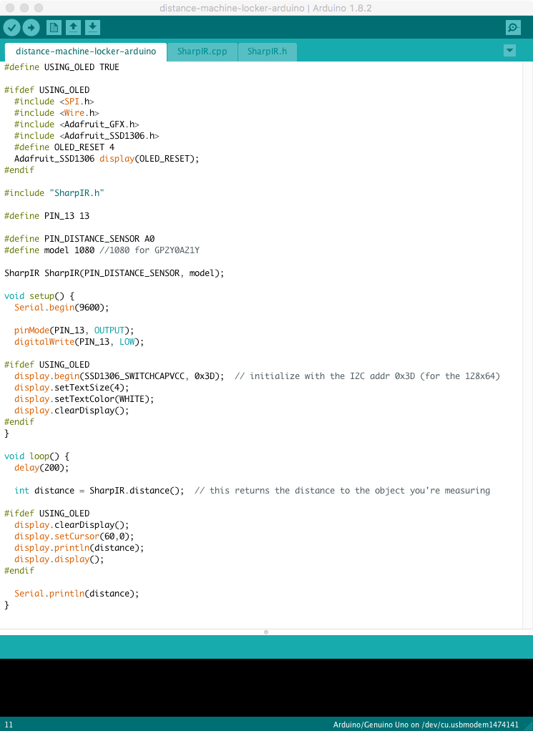
Arduino firmware
Arduino IDE
Sharp IR library
https://github.com/guillaume-rico/SharpIR
Prints cm distance via USB Serial Port

Slide 13
Host App
Swift 3 Menubar app
Receives Data from USB-Serial Port
Locks machine on threshold reached

Slide 14
About the app
Uses SwiftSerial library written by yours truly
https://github.com/yeokm1/SwiftSerial
Menubar app (MainMenu.xib, MenuController.swift)
No Main Window
No Storyboards, just a single xib
Lock screen (Locking.swift)
Use IOKit (suggested by http://stackoverflow.com/questions/1976520/lock-screen-by-api-in-mac-os-x )
CGSession –suspend hides notification
/System/Library/CoreServices/Menu Extras/User.menu/Contents/Resources/CGSession -suspend

Slide 15
Potential Hacking Strategies and Defenses

Slide 16
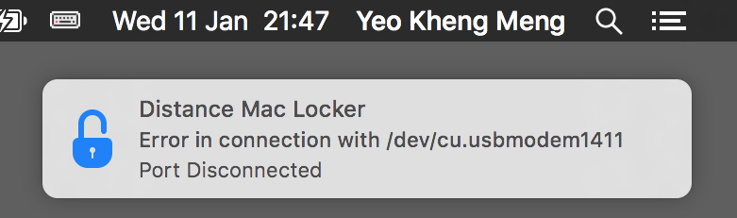
Hack 1: Disconnecting device
Defense:
Lock machine immediately
Issue system notification
Detect device disconnect: USBWatcher.swift
http://stackoverflow.com/a/41279799
Auto-reconnection
Need to delay between locking and showing notification (2 seconds)
MenuController.swift

Slide 17
Hack 2: Tamper hardware to provide incorrect values
Defense: Vigilant monitoring of distance values on menu bar

Slide 18
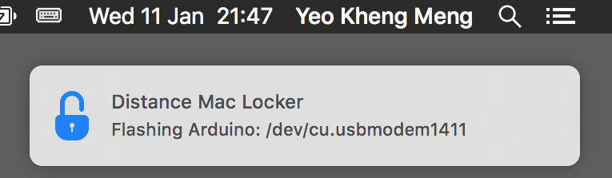
Hack 3: Reprogramming with malicious firmware
Defense: Reprogram Arduino before using it
Swift App contains hex (firmware) file exported from Arduino IDE
Flashes hex file with avrdude to Arduino before using
DistanceSensor.swift and UtilityFunctions.swift

Slide 19
A possible “undetectable” hacking strategy
Overwrite the Arduino bootloader

Slide 20
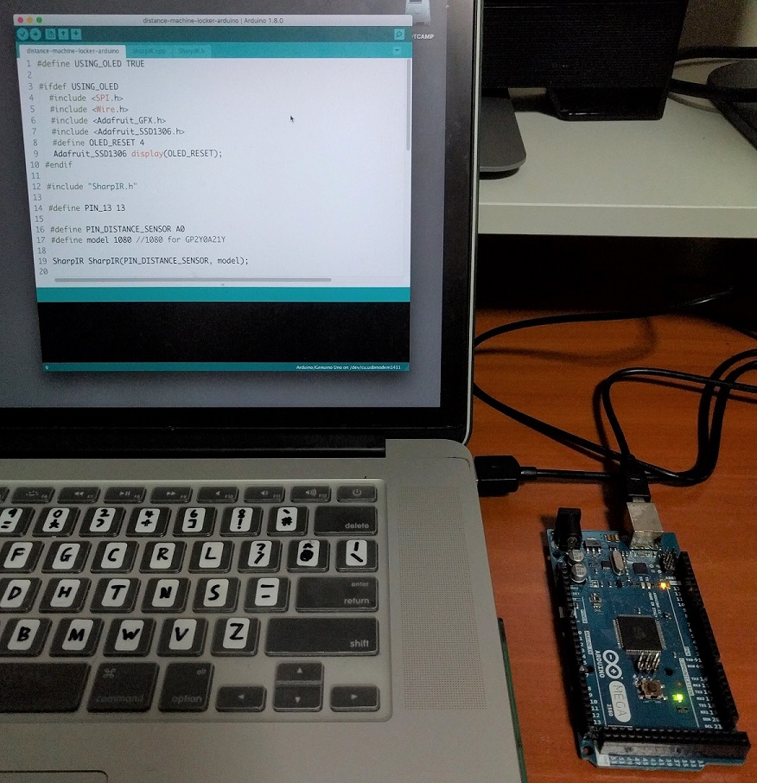
Typical Arduino Programming
Arduino IDE
USB cable

Slide 21
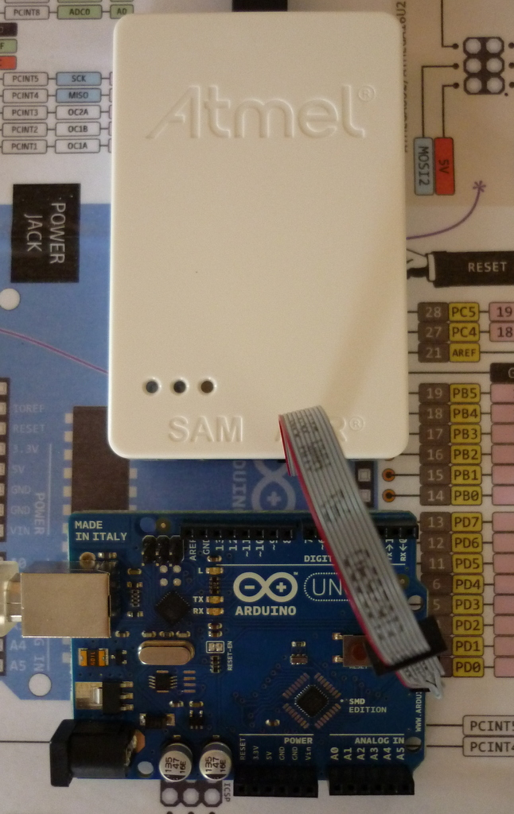
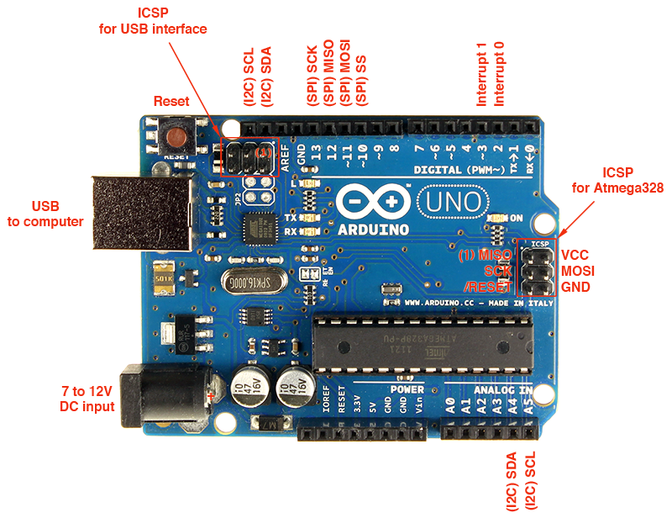

Microcontroller programming the actual way
Using dedicated programmers with ICSP port
ICSP – In-circuit system programmer
+
=
Image sources:
http://www.atmel.com/tools/atatmel-ice.aspx
http://blog.alrightythen.de/2014/08/debugging-with-the-new-atmel-ice/

Slide 22
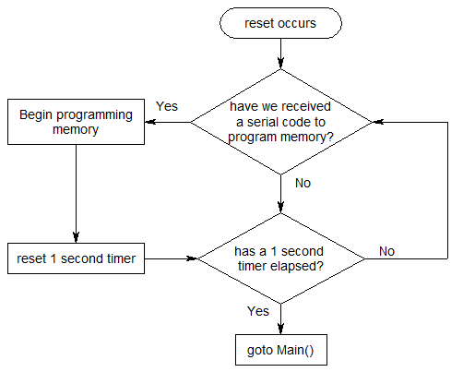
What is an Arduino bootloader?
Allows Arduino IDE to program Arduino board via USB
On reset, wait 1 second for computer to program board before resuming

Slide 23
Vina Rianti

Slide 24
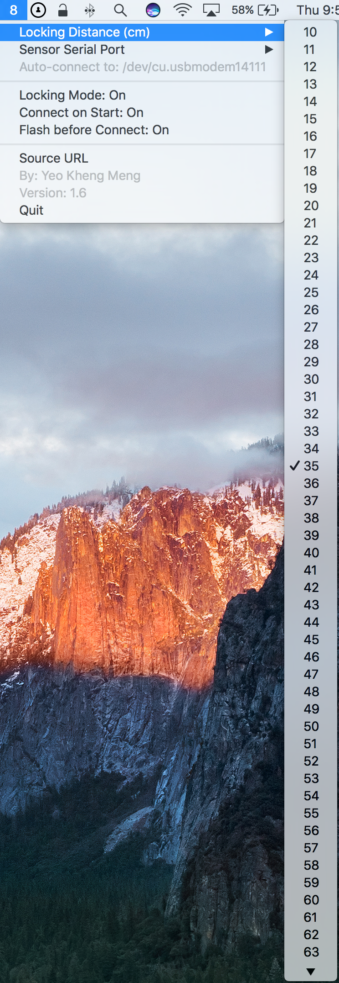
Key learnings
Experience turns into idea (or request) on how to make it better
Too fast to get locked
Distance options too long
Look at the code … it’s a Mac App!
Learn to understand how it works
What I learned?
Git fork and public repo flow
Not the usual way of coding in Swift ..
Stride
CFAbsoluteTime

Slide 25
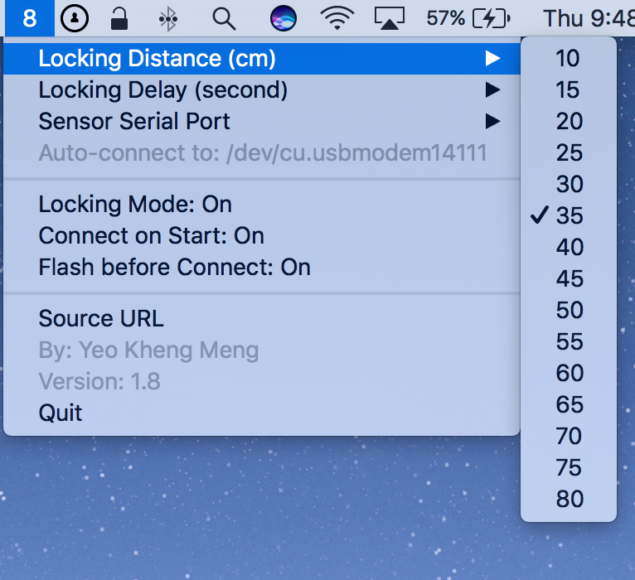
Locking Distance option for every 5 cm
Before
for distance in DISTANCE_MINIMUM...DISTANCE_MAXIMUM {
for distance in stride(from: DISTANCE_MINIMUM, through: DISTANCE_MAXIMUM, by: 5) {
let distanceMenuItem = NSMenuItem(title: String(distance), action: #selector(distanceMenuItemClicked), keyEquivalent: "")
distanceMenuItem.target = self
if distance == currentLockingDistance{
distanceMenuItem.state = NSOnState
}
distanceMenu.addItem(distanceMenuItem)
}
After

Slide 26
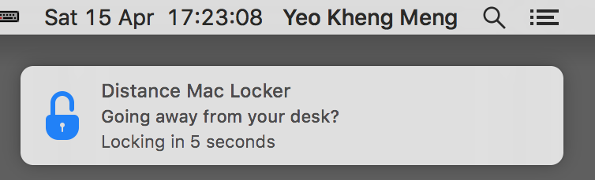
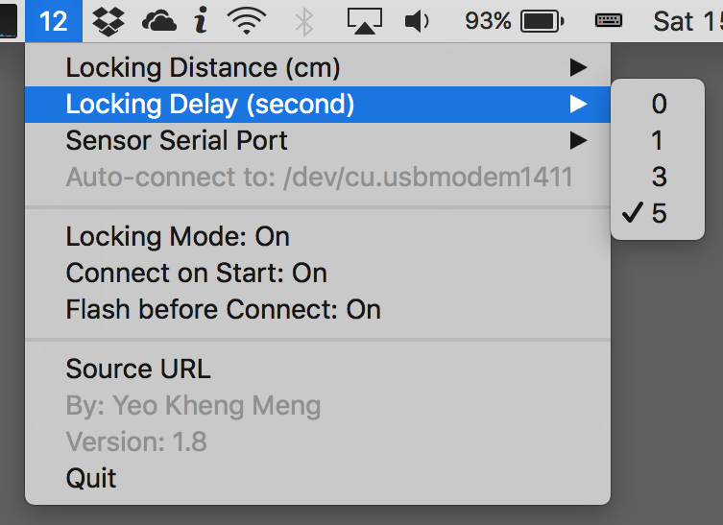
Locking Delay
func distanceReceived(distance: Int){
...
if lockingMode && distance >= currentLockingDistance {
if goingToLock == false {
goingToLock = true
startLockingWindow(start: true)
} else {
startLockingWindow(start: false)
}
} else {
goingToLock = false
}
}
func startLockingWindow(start: Bool) {
if start {
launchLockWindow = CFAbsoluteTimeGetCurrent()
} else {
let elapsed = CFAbsoluteTimeGetCurrent() - launchLockWindow
if elapsed >= Double(lockingTimeout) {
locking.lockMachine()
}
}
}

Slide 27
Hackers always win
Questions?
No physical security -> No security
https://github.com/yeokm1/distance-machine-locker

